Slide 1
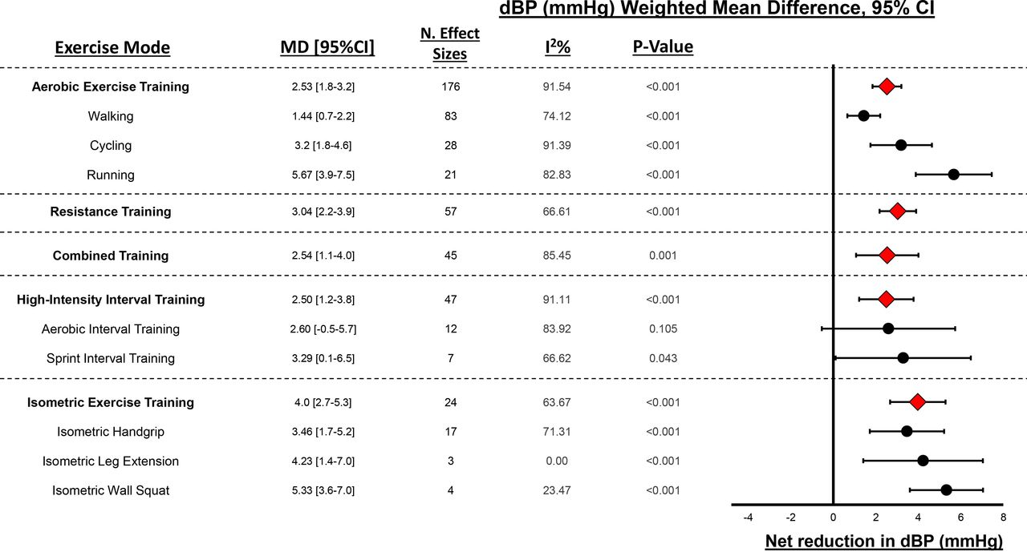

Forest plot depicting overall effects of each primary and secondary exercise mode on diastolic blood pressure (DBP).
Jamie J Edwards et al. Br J Sports Med 2023;57:1317-1326
Copyright © BMJ Publishing Group Ltd & British Association of Sport and Exercise Medicine. All rights reserved.
Notes:
Forest plot depicting overall effects of each primary and secondary exercise mode on diastolic blood pressure (DBP).

